Slide 1


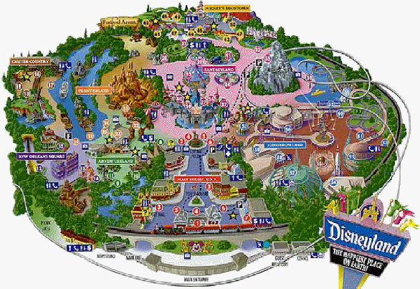
Unit 5
Theme parks

Slide 2
Discussion
Brainstorming:
chat with friends
enjoy the scenery
…
parks
have a picnic
play games
have fun
relax

Slide 3
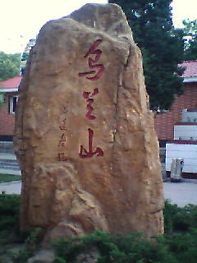
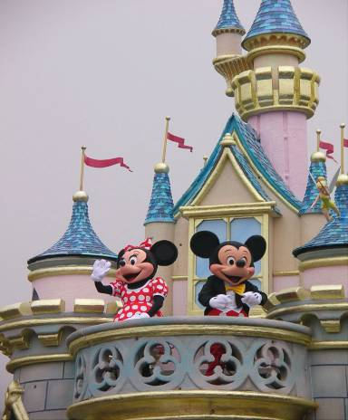
Do you know the differences between
and
a park
a theme park

Slide 4

What is a theme park?
It is a kind of amusement park
which has a certain idea---a certain theme – that the whole park is based on.

Slide 5
What kinds of theme parks do you know?
history theme park
sports theme park
marine or
ocean park
theme
parks
future park
science
theme park
culture theme park

Slide 6

There are various kinds of theme parks in Shenzhen. Would you name some theme parks you know?

Slide 7
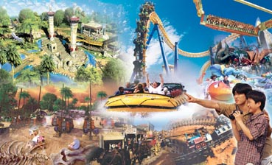
Happy Valley

Slide 8
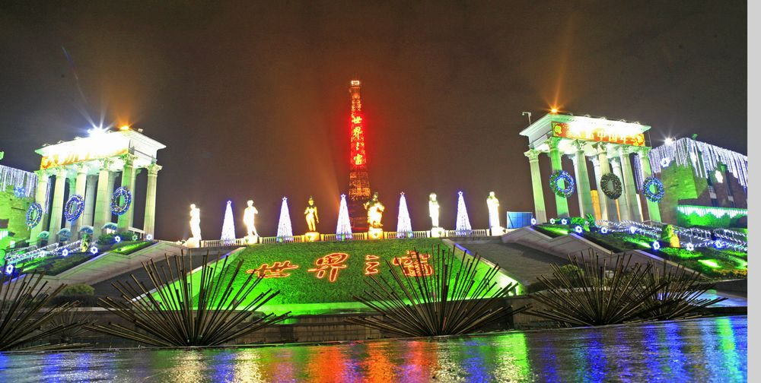
Window of the World

Slide 9
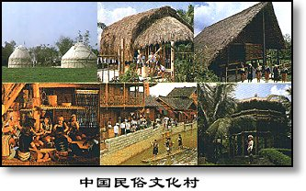
China Folk Culture Village

Slide 10
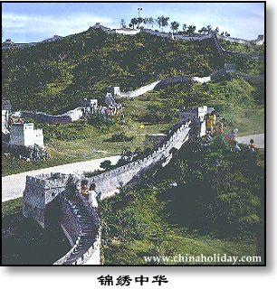
Shenzhen Splendid China

Slide 11
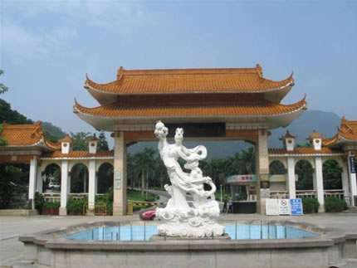
Xiahu Botanical Garden

Slide 12
Discussion
With your partner, discuss what kind of activities we can take in a theme park.

Slide 13
These theme parks have a variety of things to see and do.
Sports theme park:
Sports to play or watch; physical exercise and athletic competition.
History theme park:
See how ancestors dressed, worked and lived.
Culture theme park:
See how special groups dress today, what they eat and what the homes look like, cook culture food, take pictures in the special clothing.

Slide 14
Marine or ocean theme park:
See and swim with dolphins and learn about ocean life.
Science theme park:
Take part in experiments.
future park:
Go on imaginary trip to space and experience life in the future.

Slide 15
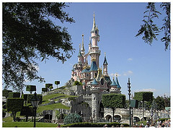
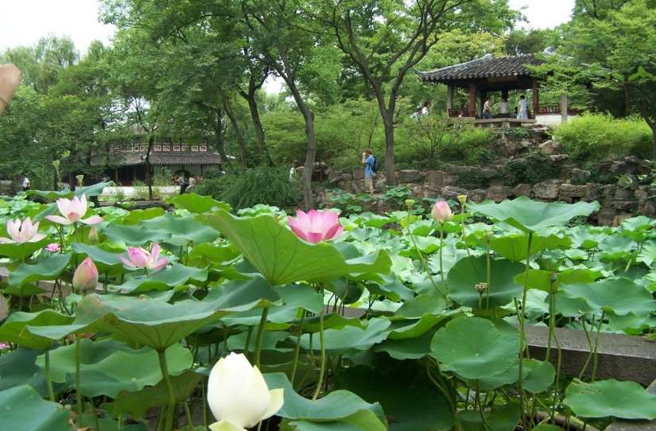
Difference between an ordinary park and a theme park
theme park
knowledge
amusement
A garden in Suzhou
Disneyland
Theme parks combine fun with learning

Slide 16



Skimming
Reading Comprehension I
Answer the question.
What is the meaning of the title “Theme
Parks - Fun and More Than Fun”?
The title means that theme parks are fun to visit, but that they can also be educational and can offer useful information.

Slide 17

Skimming
Reading Comprehension II
Choose the best answer.
What’s the text mainly about?
A. The differences among theme parks.
B. An introduction to three theme parks.
C. Theme parks are more than fun.
D. Disneyland is more popular than other
theme parks.

Slide 18
Skimming
Reading Comprehension III
Find the topic sentence of each paragraph and.
Para. 1
There are various kinds of theme parks
Para. 2
If you want to have fun and more
than fun, come to Disneyland.
Para. 3
Come to Dollywood to have fun
learning all about America’s historical
southeastern culture.
Para. 4
To enter a world of fantasy about
ancient England, come to Camelot Park.

Slide 19
Scanning
Reading Comprehension V
Complete the table below.
Park name | Theme | Example of Activities
Disneyland
Dollywood
Camelot

Slide 20
Park name | Theme | Example of Activities
Disneyland
fairy tale
stories
travel through space, visit a pirate ship, meet fairy tale or Disney cartoon character, ride a swinging ship, go on a free-fall drop

Slide 21
Park name | Theme | Example of Activities
Dolly- wood
listen to American country music,
see traditional craftsmen and their work,
try some traditional candy,
ride on an old steam-engine train,
see bald eagles,
ride on Thunderhead and other rides
culture of
the
south-eastern
USA

Slide 22
Park name | Theme | Example of Activities
Camelot
ancient English history and stories
watch magic show,
see fighting with swords or on horseback,
visit farm area,
learn about farms in ancient England

Slide 23

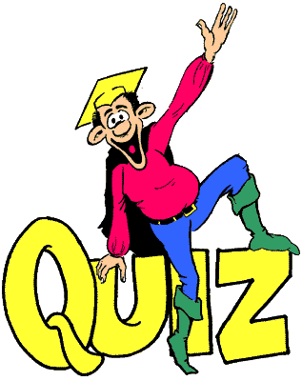
Individual activity

Slide 24
Retell the text by filling in the following blanks.
There are 1___ ____(vary) kinds of theme parks with a different park for almost everything: food, culture, science, cartoons, movies or history. Some parks are famous for having the biggest or longest roller coasters, 2_________ for showing the famous sights and sounds of a culture. The theme park you are _________(probable) most familiar with is Disneyland, which can make your dreams come true. 4_________ you wander around the fantasy amusement park, you may see Snow White or Mickey Mouse. With so many 5_________(attract), no wonder tourism is increasing 6________ there is a Disneyland. Dollywood, in the beautiful Smoky

Slide 25
Mountains in the southeastern USA, is one of the most unique theme parks in the world, where the main attraction is 7____ ___ culture. If you want to learn all about American historical southeastern culture, you can come to Dollywood 8____ ___ (have) fun. If you want to experience the ancient days, then England’s Camelot Park is the place for you, where every area of the park is 9_________(model) after life in the days of King Arthur and the Knights of the Round Table. In a word, it’s 10________ world of fantasy about ancient England.
1.various 2. others 3. probably
4. As 5. attractions 6. wherever
7. its 8. to have 9. modelled
10. a

Slide 26
V-ing (令人…的）&V-ed （感到…的）
satisfy
excite
confuse
relax
inspire
tire

Slide 27
The _______(surprise) look on her face suggested that she hadn’t known it before.
To tell you the _____(true), I think it ______(embarrass)to speak English before a machine.
It’s ______(true) an honor to take part in the English speaking contest.

Slide 28
Remain 的用法
Please remain______(seat) until the plane has come to a complete stop
It remains _________(see)whether you are right.
With many major economic problems____(remain)to be solved, there is no point predicting the growth rate of this year now.
The guests had their meal and left, with nothing ______(remain/leave) on the table.
Nothing ______(remain/leave) after the great fire.

Slide 29
I spend little time practicing English though I am always the first in the ___5___(write) exam.
To my delight, when ___8__(give) the test paper today, I found the questions not so difficult as ____9____(expect)

Slide 30

高考实战
(2010四川) A great number of students ___________ said they were forced to practise the piano.
A. to question B. to be questioned
C. questioned D. questioning

Slide 31
(2009·全国Ⅰ)
Now that we’ve discussed our problem, are people happy with the decisions ______？
A. taking B. take
C. taken D. to take

Slide 32
高考实战
【2011福建卷】Tsinghua University, ________ in 1911, is home to a great number of outstanding figures.
A. found B. founding
C. founded D. to be founded

Slide 33
高考实战
(2010北京)I’m calling to enquire about the position____________ in yesterday’s China Daily.
A. advertised B. to be advertised
C. advertising D. having advertised

Slide 34
高考实战
(2011·江苏) Recently a survey ________ prices of the same goods in two different supermarkets has caused heated debate among citizens.
A．compared B．comparing
C．compares D．being compared

Slide 35
高考实战
(2008湖南)The trees ______ in the storm have been moved off the road.
A．being blown down
blown down
blowing down
D. to blow down

Slide 36
(2009·福建)
______ not to miss the flight at 15：20, the manager set out for the airport in a hurry.
A. Reminding B. Reminded
C. To remind D. Having reminded

Slide 37
(2009·重庆)
Michael’s new house is like a huge palace, ______ with his old one.
A. comparing B. compares
C. to compare D. compared

Slide 38
(2009·天津)
______ by the advances in technology, many farmers have set up wind farms on their land.
A. Being encouraged B. Encouraging
C. Encouraged D.Having encouraged

Slide 39
(2009·龙岩毕业班质检)
Realizing I would be late, I quickly dressed my son and, ______ my bag, went to work.
A. carried B. having carried
C. to carry D. carrying

Slide 40
(2009·福建)
In April, 2009, President Hu inspected the warships in Qingdao, ______ the 60th anniversary of the founding of the PLA Navy.
A. marking B. marked
C. having marked D. being marked

Slide 41
(2009·金丽衢十二校联考)
______ by his grandparents in the countryside, he isn’t accustomed to ______ in the city.
A. Having brought up; live
B. Grown up; living
C. Growing up; live
D. Brought up; living

Slide 42
［2011·江西卷］
On receiving a phone call from his wife ________ she had a fall, Mr. Gordon immediately rushed home from office.
A．says B．said
C．saying D．to say

Slide 43
(2011·上海)
________in 1955, Disneyland in California is regarded by many as the original fun park.
A. Opened B. Having opened
C. Opening D. Being opened

Slide 44
(2011·天津)
________into English, the sentence was found to have an entirely different word order.
A. Translating B. Translated
C. To translate D. Having translated

Slide 45
The flowers _______ sweet in the botanic garden attract the visitors to the beauty of nature.
A. to smell B. smelling
C. smelt D. to be smelt

Slide 46
Don’t use words, expressions, or phrases __________ only to people with specific knowledge.
A. being known B. having been known
C. to be known D. known

Slide 47
高考中分词的考查点
doing
done
done
being done
to be done
doing
having done

Slide 48
分词考点的两个误区
being done
done
done
having done

Slide 49
(2009·北京)
______ twice, the postman refused to deliver our letters unless we chained our dog.
A. Being bitten B. Bitten
C. Having bitten D. To be bitten

Slide 50

（10天津12）
It rained heavily in the south，______ serious flooding in several provinces.
A. caused B. having caused
C. causing D. to cause

Slide 51
重点单词讲解
1.various adj.各种不同的；各种各样的
__________v.有差异；变化；改变
__________n.不同种类；变种；变化
_______________________[搭配]多种多样的；种种
vary
variety
a variety of/varieties of

Slide 52
1). Of all the ________ (variety) methods of learning a foreign language, I think this is the best.
2). ________ (variety) of TV programmes are being broadcast on TV at present.
3). Prices vary _____ five yuan ____ ten yuan.
4). The flowers varied ______ color and size.
various
Varieties
from to
in

Slide 53
由于各种原因，我不愿见他。
For various (kinds of )reasons, I prefer not to meet him.
我们的主题公园有各种各样的娱乐设施，你总能找到一款适合你们小孩的。
There are a variety of amusement facilities in our theme park, so you can always find one suitable for your children.
人们对是否中学就把孩子送出国学习有不同看法。
People’s views on whether middle school students
should be sent abroad for study vary from person to
person.

Slide 54
2. be famous for
纽约以其摩天大楼驰名，每年吸引了大量的游客。
Famous for its skyscrapers, New York attracts a large number of tourists every year.
be famous for =be known for
be famous for = be known as
作为…而闻名
以……而闻名

Slide 55
北京， 作为中国首都，正遭受严重的污染。
Beijing, known as the capital of China, is being polluted severely/seriously.

Slide 56

3. whichever& no matter which
______ team wins on Saturday will go through to the national championships. (2006山东)
A. No matter what
B. No matter which
C. Whatever
D. Whichever

Slide 57
1. Sarah hopes to become a friend of ______shares her interests.
anyone B. whomever
C. whoever D. no matter who
2. _____leaves the room last ought to switch off the light.
Anyone B. Who
C. Whoever D. No matter who
3. _____much advice I gave him, he did exactly what he wanted to do.
How B. Whatever
C. However D. What

Slide 58
______ breaks the law is to be punished.
We’ll remember ______ we turned to for help.

Slide 59
4. amuse v. 使发笑；使愉快
These toys will help to keep the baby _______.
To my great___________, his false
beard fell off.
Our visits to the theatre made the holiday more ________.
Everyone was _______ at the story about the dog.
amused
amusement
amusing
amused

Slide 60
5. no wonder 难怪；不足为奇
难怪孩子们很兴奋，这是他们第一次出国。
（It is）No wonder the children are excited---this is the first time they’ve been abroad.
毫无疑问， 中国人民的生活比三十年前的好多了。
There is no doubt that people in china are much better of than they were 30 years ago.

Slide 61
Its 3-D cinemas and giant movie screen provide brand new experience of the earth and beyond.
The amazing, up-to-date information together with many opportunities for hands-on learning make the world come to life in a completely new way for visitors.
For anyone coming from out of town, Futuroscope has many excellent hotels, most of which provide a shuttle service to the park.

Slide 62
高 考 链 接
1. Vincent received training in painting for a couple of years, ______ he found a job in a big factory.
A. after that B. after which
C. during that D. during which
2. People have lots of problems living in the Central Australian desert, ______ getting water is the most serious.
A. of which B. which C. for which D. through which
3. The English play ______ my students acted at the New Year’s party was a great success.
A. for which B. at which C. in which D. on which
4. Last week, Only two people came to look at the house, _______ wanted to buy it.
A. none of them B. both of them
C. neither of whom D. none of whom
B
A
C
C

Slide 63
6. English is a language shared by several diverse cultures, each of____ uses it somewhat differently .（2011浙江）
A. which B. what C. them D. those
7. She showed the visitors around the museum, the construction _____had taken more than three years. （2011江西）
A. for which B. with which
C. of which D. to which
8. Julie was good at German, French and Russian, all of _______ she spoke fluently.
A. who B. whom C. which D. that
（2011湖南）
A
C
C

Slide 64
语 篇 运 用
Football is popular in our school. I’ve been one of the students of achievement _______ I feel much proud. I would like to thank Mr. Zhang, ________________I would never have learned to play football well. He taught me to dribble the ball, ____________________I will always be grateful. It is a basic skill in football. The ways _________ he encouraged me have gradually built my confidence. He is a man _________ I have the highest respect. We may forget what he said yesterday, but we will never forget how he made us feel.
of which
without whom
to whom／for which
in which
for whom

Slide 65
Is/was this the first time that you ______(fly) to Paris.
It is high time that we _______(take) effective measures to fight against the increasingly serious pollution.
The boy was floating his boat in spite of the bad weather while other people were sheltering in the house.

Slide 66
in spite of & despite
(prep.)
尽管他生病了，他还是来开会了。
He came to the meeting despite/in spite of his illness.
He came to the meeting despite/in spite of the fact that he was ill.
尽管我们在生活中遇到很多困难，我们也决不能放弃。
Despite the fact that we will encounter great difficulties in life, we should never give up.
Despite great difficulties we will encounter in life, we should never give up.

Slide 67
In spite of the fact that women perform better in terms of academic performances, they are not able to make it to the top the work setting.
In spite of the fact that thieves are universally despised, they do have some admirable qualities that society can learn from for its progress.

Slide 68
Only when you look into the truth can you make a conclusion for the cause of the accident.
Only if you put the sun there did the movements of the other planets in the sky makes sense.(Page 13)

Slide 69
Only if & if only
只有我找到了工作才有足够的钱上学。
Only if I get a job will I have enough money to go to school.
只有得到老师的允许，学生才可以这间屋。
Only if a teacher has given permission is a student allowed to enter this room.
He looks upset. If only he _______(pass) the exam.

Slide 70
By 的用法 （表增减程度）
Tommy defeated Jack _____about 0.5 meter and won the race in the end.
The bullet missed me ______2 inches.
The rope needs to be longer _____two feet.

Slide 71
attend 的用法
If you go out, who will attend to the baby.
I may be late. I have one or two things to attend to.

Slide 72
In summer, ______(expose) to the sun is harmful to your skin.
In summer, _______(expose) to the sun for a long time, you’ll be sunburnt.

Slide 73
cure sb of sth
suspect sb. of doing sth
inform sb. of sth
rob. sb of sth
accuse. sb of sth
remind. sb of sth

Slide 74
Suggest 的用法
All the evidence suggests that he ________(steal) the money.
Her parents suggested that she ______(have) a medical examination.
我建议政府采取有效措施治理拥堵问题。
I suggest that the government (should) take effective measures to deal with the congestion.

Slide 75
______(absorb) in today’s newspaper, he failed to hear the bell.
The novel was so _______(absorb) that she read on without a brak, even forgetting food and sleep.

Slide 76
She is such a kind teacher ______we all like her.
She is such a kind teacher ______we all like.

Slide 77
1. I want to use the same dictionary ______was used yesterday.
A. which B. who C. what D. as
2. He isn't such a man ______he used to be.
A. who B. whom C. that D. as
3. He is good at English, ______we all know.
A. that B. as C. whom D. what
4. John got beaten in the game, _______ had been expected.
A. as B. that C. what D. who
5. I have bought such a watch _______ was advertised on TV.
A. that B. which C. as D. it
6. I want to use the same tools _______used in your factory a few
days ago.
A. as was B. which was C. as were D. which
7. He is not such a man _______ would leave his work half done.
A. that B. which C. who D. as

Slide 78
________ is known to all, success results from hard work.
________is known to all that success results from hard work.
________is known to all is that success results from hard work.

Slide 79
Blame 的用法
He was so careless that he was ________(blame) for the accident.
________(blame) for making mistakes in speaking English, he looked very upset.
Air pollution will be partly ______(blame) such a temperature rise.

Slide 80
In addition to, Apart from, Besides
除了可以强身健体， 经常性的体育锻炼还可以放松身心。
Apart from strengthening our body, doing physical exercise on a regular basis can also refresh our mind.

Slide 81
He placed a fixed sun at the center of the solar system with the planets going round it and only the moon still going round the earth.

Slide 82
高考中with 的考察
1. John received an invitation to dinner, and with his work _______, he gladly accepted it.（2007 安徽）
A. finished B. finishing C. having finished D. was finished
2.----Come on, please give me some ideas about the project.
----Sorry. With so much work _______ my mind, I almost
break down. (2007 福建)
A. filled B. filling C. to fill D. being filled
3. The girl sat there quite silent and still with her
eyes_______on the wall.
A. fixing B. fixed C.to be fixing D. being fixed
4. They pretended to be working hard all night with their
lights____.
A.burn B.burnt C.burning D.to burn

Slide 83
enthusiastic
be enthusiastic about
show great enthusiasm for

Slide 84
encourage en-courage
enable en-able
enlarge en-large
ensure en-sure
enrich en-rich

Slide 85
Thinking that way does you no good, and there is a huge chance that you’re wrong any way.
If you’re a Harry Potter fan, chances are that you simply can’t get enough of the wizarding(魔法）world.（Teens P4 ）
I have a strong enthusiasm for drawing and linguistics, so chances are that I will try a designer or a linguist in the future. (Teens Page 3)

Slide 86
affect & effect
affect=have/exert an effect on
negatively/positively affect
exert a positive/negative effect on

Slide 87
Subjunctive Mood
He often said that his success would certainly have been achieved by others if he had never lived.
Would rather that
It’s high time that…
suggest that…
If only…

Slide 88
【Find the rules（自我发现）】
1.Contrary to the present（与现在事实相反）
If I were you , I would study hard.
If I had a lot of money now, I would travel around the world.
If I lived on the moon at present, I might see the beauty—Chang’e.
would/could/
might/should do
（动词原形）
If…________sth,… ________________ sth.
did/were
（过去式）
were

Slide 89
PRACTICE
1.If everyone __________(live) a low-carbon life now, the earth _________(be) saved.
2.If I_________(win) the lottery, I __________(buy) an expensive car.
3. If he ____ (be) in your position, he _________ (ask) for teacher’s help.

Slide 90
【Find the rules（自我发现）】
2.Contrary to the past（与过去相反）
If you had attended the meeting yesterday, you would have met her.
If the doctor had come last night, the boy would have been saved.
If …______ sth, … ________________ sth.
had done
（过去完成）
would/could/might/should
have done
（现在完成）

Slide 91
PRACTICE .
a. If Tom ________ (be) more careful in the exam, he ________________ (pass) it already.
b. If you _______ (get) up earlier, you ________________ (catch) the first train.
c. If I _______ (meet) you yesterday, we ______________ (go) to the concert together.
had been
would have passed
had got
would have caught
had met
would have gone

Slide 92
【Find the rules（自我发现）】
3.Contrary to the future（与将来事实相反）
If I had time next week, I would help you.
If I should have time next week, I would help you.
If I were to have time next week, I would help you.
If…_______sth,… _________________sth.
did/were
were to do
should do
would/could/
might/should do（原形）

Slide 93
a. If there ________ (be) no natural resource any more, we ___________ (make) use of nuclear power .
b. What ____________ (happen) if you ____________ (get up) too late tomorrow?
c. If Robots _____________ (control) the world some day, here ________ (be) no friendship.

Slide 94
小结：虚拟语气在条件从句中的用法
条件 从句 | If 从句谓语形式 | 主句的谓语形式
现在 (Present)
过去 (Past)
未来 (Future)
过去式(did/were)
would/could/
should/might +V.
would/could/should/might +have done
过去完成式
(had done)
过去式/
did/should/
were to +V
would/could/should/might +V. (原)

Slide 95
高 考 链 接
1. If we __________adequate preparations,
the conference wouldn‘t have been so successful.(2012 山东高考）
A haven't made B wouldn't make
C didn‘t make D hadn't made
2. Had they known what was coming next,they _______second thoughts （2012浙江高考）
A. may have B. could have
C. must have had D. might have had
3. Sorry,I am too busy now.If I ____time,I would certainly go for an outing with you.（2012湖南高考）
A. have had B. had have C. have D. had

Slide 96
The old temple ______(date) back to Tang Dynasty needs _______(repair).
He was probably the first in the middle ages________(suggest) that we must learn science by observing and experimenting on the things around us.

Slide 97
It was Galileo’s spirit of going direct to Nature and proving our opinions and theories by experiment that has led to all the discoveries of modern science.

Slide 98
强调句的重难点
1. Was it in the room____Mr. Johnson lived ____the exhibition was held?
A. that; that B. where; that
C .where; where D. that; where
2. It was in the small house ______ was built with stones by his father ______ he spent his childhood.
which, that B. that, which
C. which, which D. that, where
3. It was just in the room _____ he was born _____ he died.
A. where, which B. that, that
C. where, that D. which, that

Slide 99
4. It was not until midnight ____ they reached the camp site.
（08重庆）
that B. when C. while D. as
5. Was it not until you began to work _____________how much time you had wasted?
A. did you realize B. that you realized
C. did you not realize D. that you didn’t realize
6. Not until all the fish died in the river _____ how serious the pollution was.
A. did the villagers realize B. the villagers realized
C. the villagers did realize D. didn't the villagers realize

Slide 100
7. Where did you find the professor who made the speech yesterday?
It was in the hall ______ the students often have a meeting.
where B. which C. that D. when
8. --- Where did you get to know her?
--- It was on the farm ____ we worked. （07山东）
A．that B. there C. which D. where
9. ---When did you meet him?
---It’s on the afternoon ________ I went to the movie.
A. that B. which C. when D. where

